Slide 1
Team 4 Capstone Project Supply Chain Data Engineering & Analytics on Azure Cloud
Team: Nithin
Dheeraj
Moris
Suvrajeet
Siddarth

Slide 2
Outline
Problem Statement
Objective
Microservices
Project Overview
Phase 1
Phase 2
Phase 3
Phase 4
Technology and Tools Used
Conclusion

Slide 3
Objective
Define system design and data documentation using SDLC, SRS, HLD, and UML artifacts.
Ingest multi-source supply chain data (shipments, inventory, claims, etc.).
Apply SQL and Pandas for data cleaning, transformation, and summarization.
Build FastAPI microservices to expose key metrics like delivery status and claim history.
Use Azure Data Lake, Azure Data Factory, and simulated pipelines for cloud integration.
Visualize KPIs such as delivery duration trends and inventory health via Python dashboards

Slide 4

Problem Statement
Global supply chains suffer from fragmented data, causing delays, stockouts, and disputes that increase costs. A cloud-first platform is needed to integrate this data and provide real-time visibility for better decision-making.

Slide 5
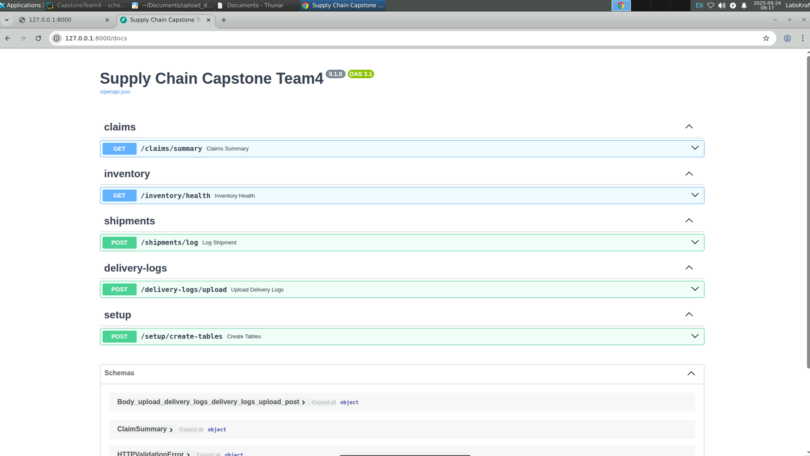
Microservices
FASTAPI
Azure Databricks
MySQL
Azure Data Factory
Azure Data Lakes
Python Frameworks

Slide 6
Project Overview
Supply chain data is fragmented across shipments, vendors, inventory, and claims.
This fragmentation causes inefficiencies, delays, and higher costs.
A cloud-native supply chain analytics platform is developed on Microsoft Azure.
Data is ingested into ADLS and processed using ADF pipelines.
Cleaned data is stored in Azure and exposed through FastAPI microservices.
The platform improves visibility, reduces disruptions, and optimizes operations.

Slide 7
SRS Documentation
Phase 1
Purpose
Develop a cloud-based supply chain analytics platform.
Enable real-time visibility into orders, delivery status, claims & inventory.
Scope
Ingest multi-source data into Azure Data Lake.
Transform data using Azure Data Factory + Python/SQL.
Expose FastAPI microservices for real-time insights.
Provide dashboards for KPIs (shipment delays, claims, inventory health).
.

Slide 8
Phase 1
Key Features
Shipment Tracker → monitor status & delays.
Claims Monitor → manage claim lifecycle & summaries.
Vendor Inventory Viewer → stock levels, reorder alerts.
Dashboards → real-time supply chain visibility.
Users
Admin → manage ingestion & APIs.
Business Analyst → consume dashboards.
Vendors/Managers → track shipments, stock, claims

Slide 9
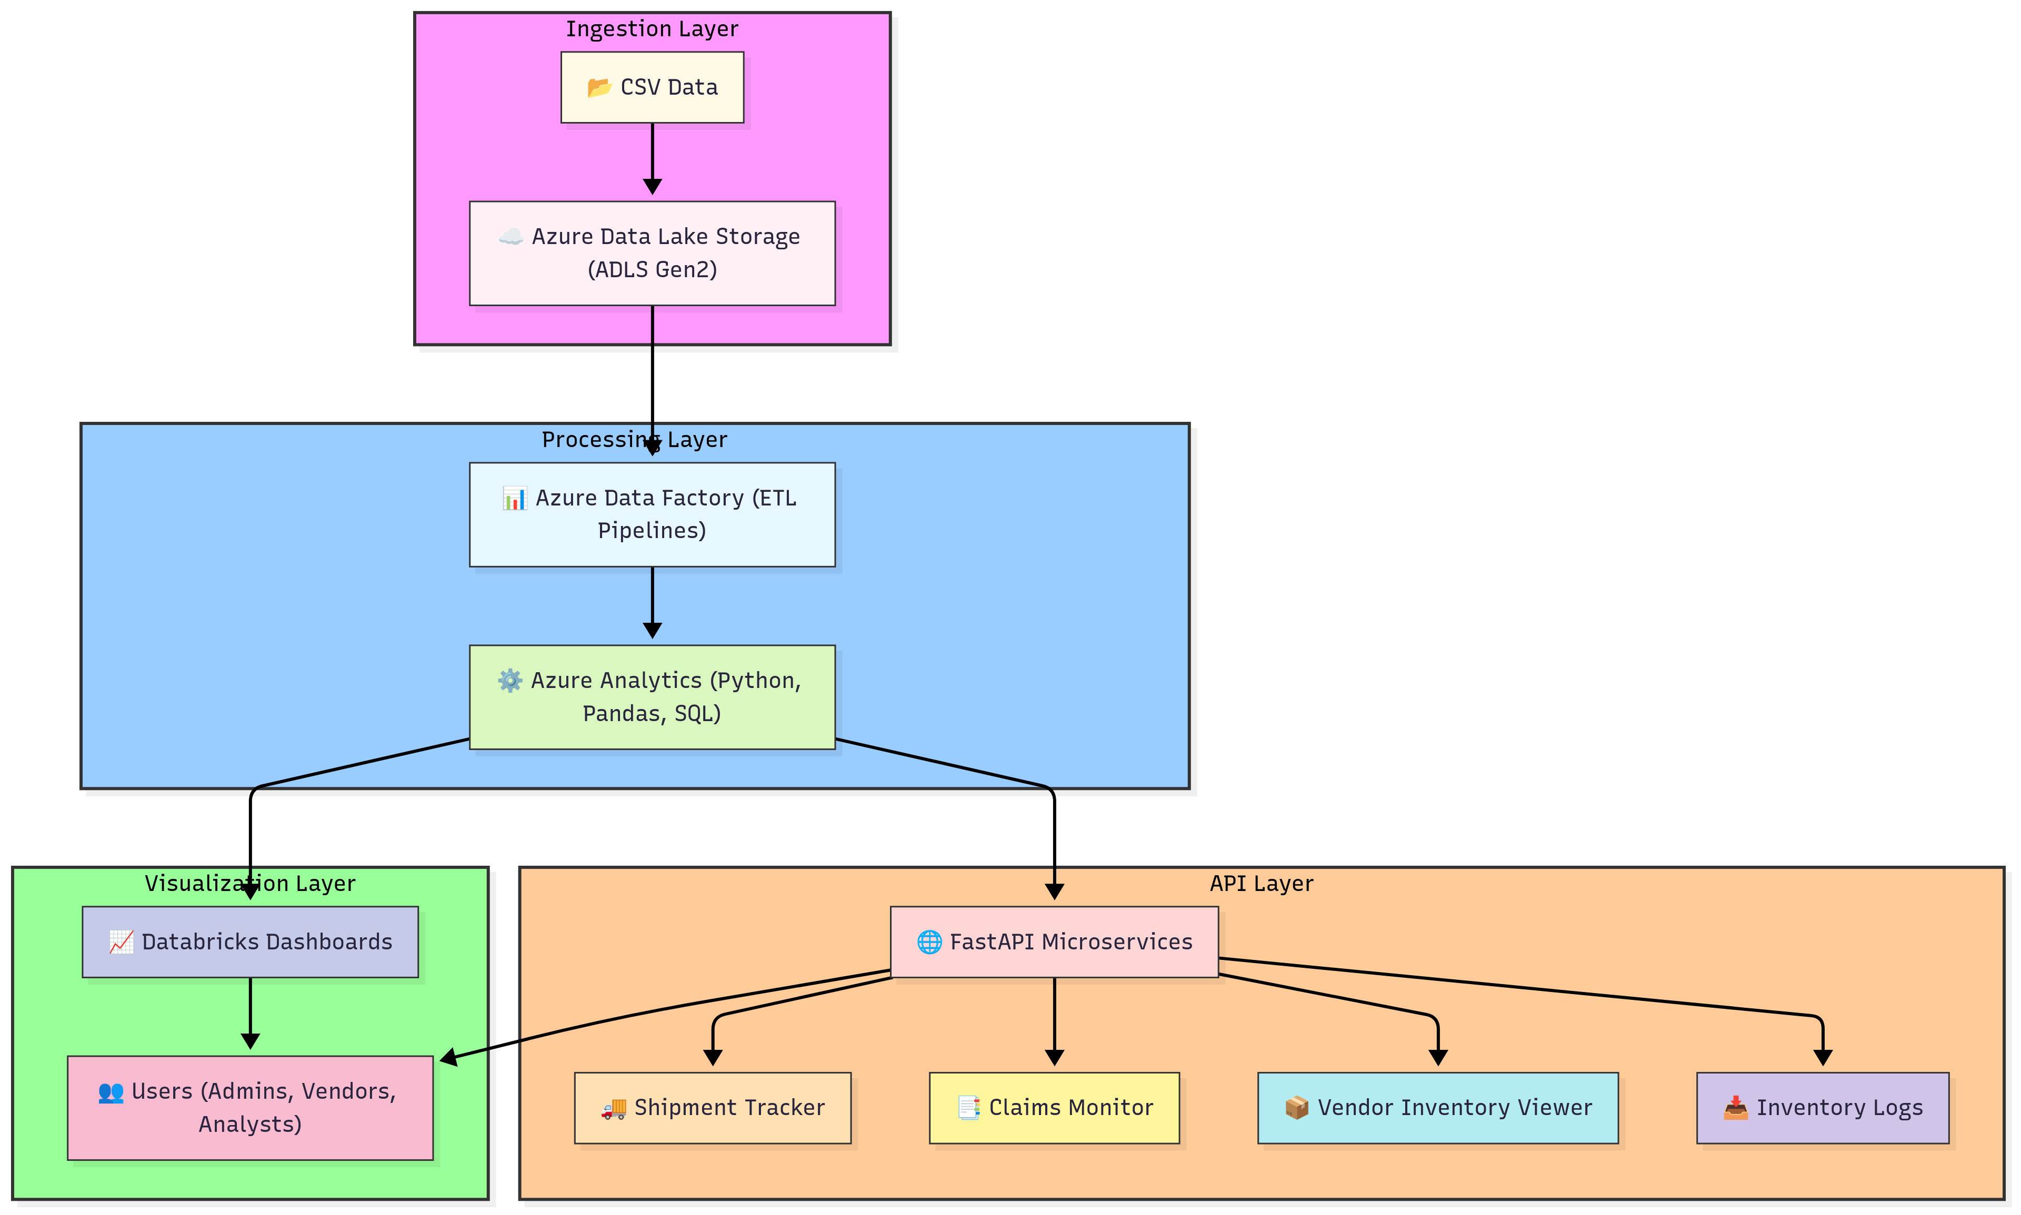
Phase 1
Project Overview (HLD)

Slide 10
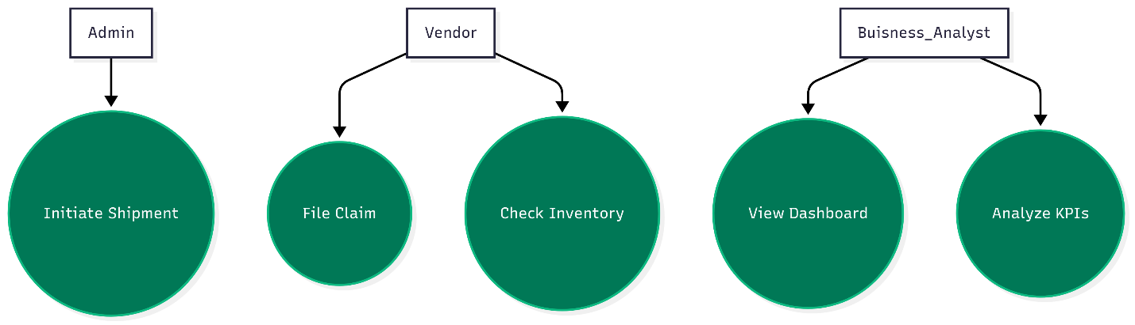
Phase 1
UML Diagram (Use case)

Slide 11
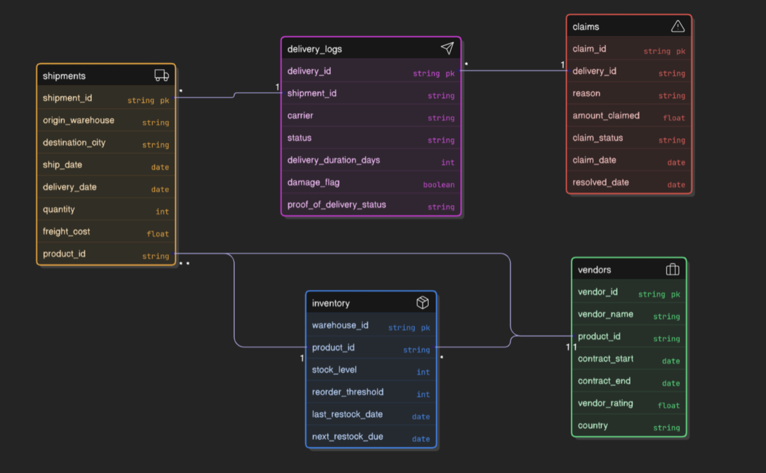
Phase 1
UML Diagram (Class)

Slide 12
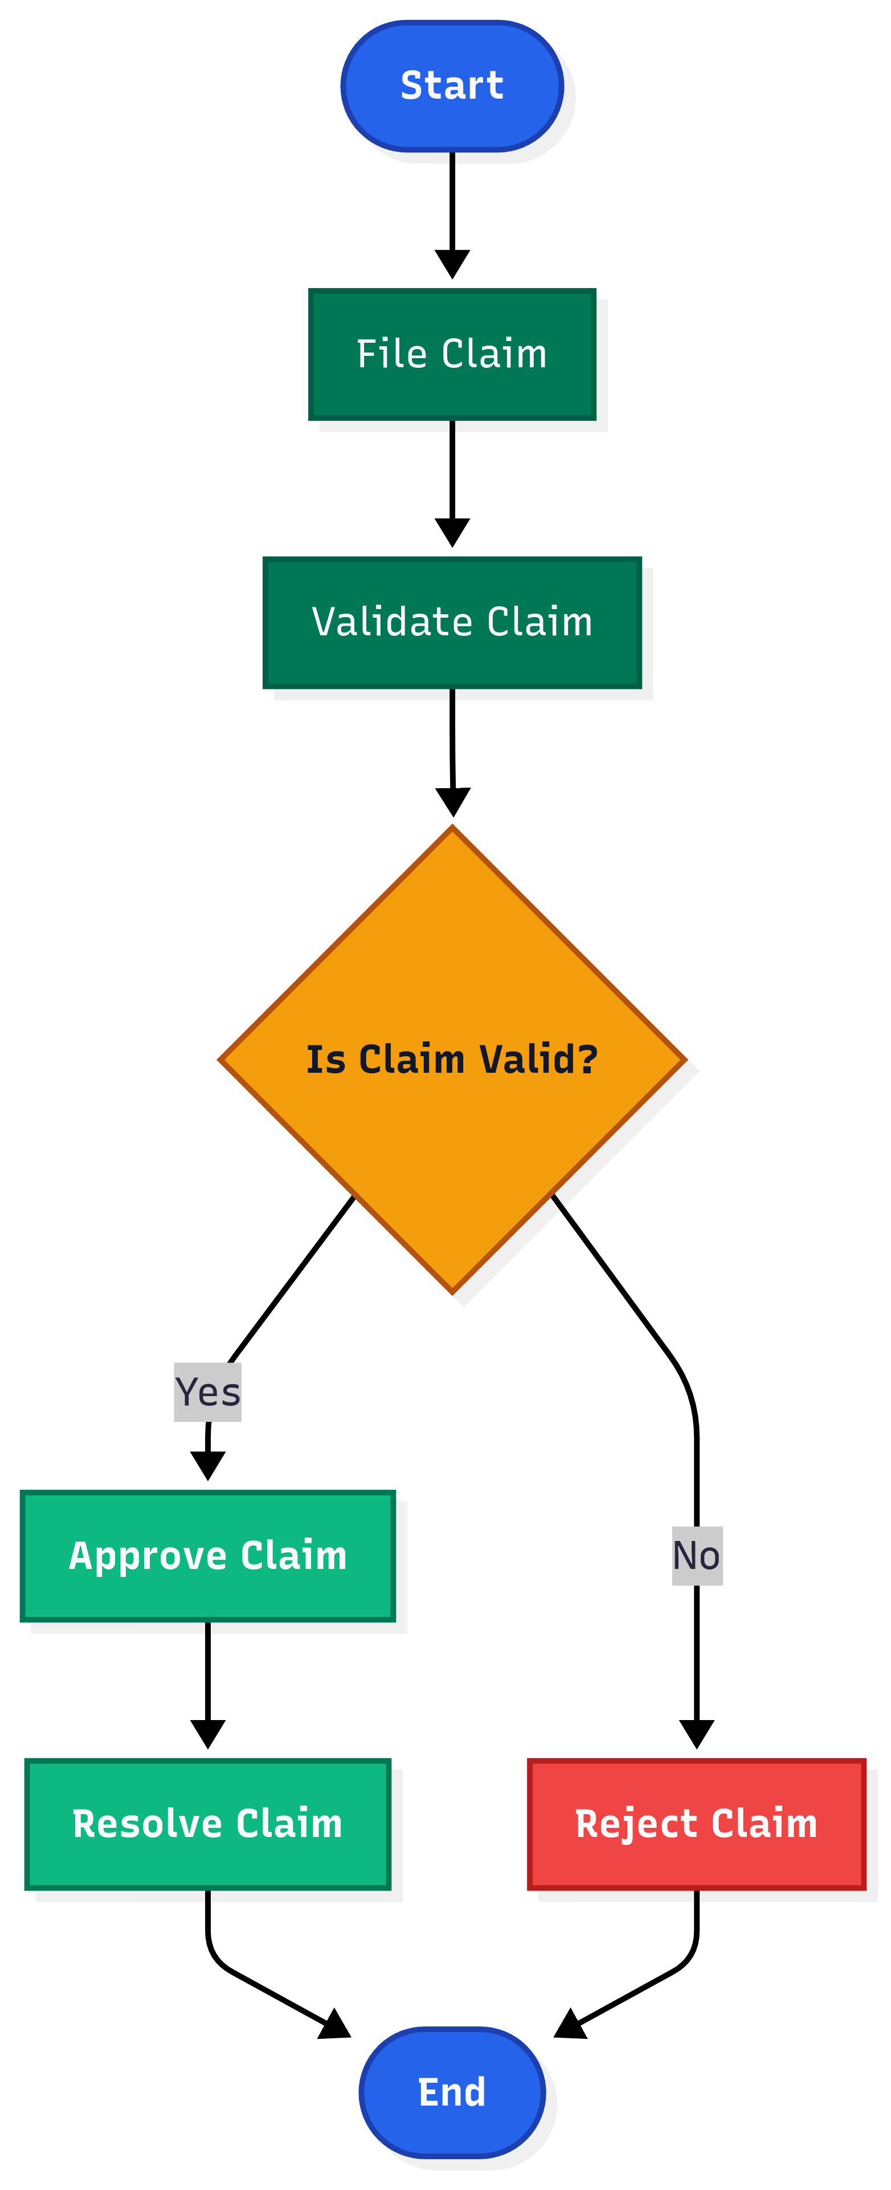
Phase 1
UML Diagram (Activity)

Slide 13
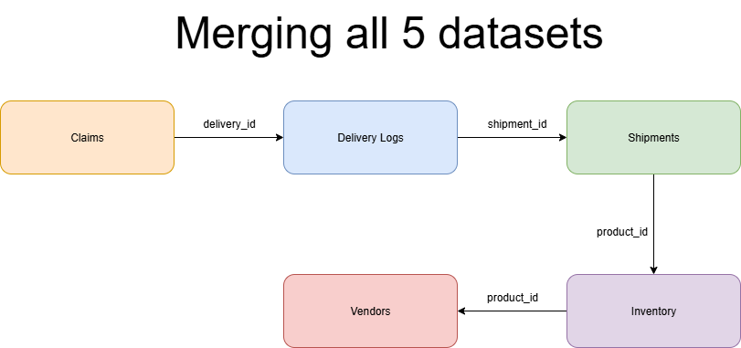
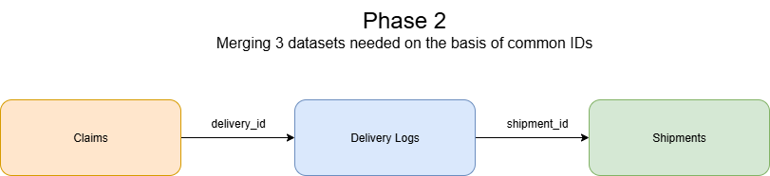
Phase 2

Slide 14
Merged Files
Phase 2
Merged Data (all 5 Data Sets)
Inventory Merged (Estimating Reorder flag)
Phase 2 Merging (3 Data sets merged for delay days and claim aging days)
merged_data_final 1.csv
inventory_final.csv
oprs2_merged_data_final.csv

Slide 15
Phase 2 -Live Demo
Use Python with Pandas to: Clean and merge shipment, delivery, and claim data.
Calculate delay duration, reorder flags, claim aging.
Write SQL scripts for: Joins across shipment–delivery–claim tables.
Aggregate freight costs by city, average claim amounts.
Grouped summaries by carrier or vendor.
Use Views and Subqueries for reporting stock health or unresolved claims.

Slide 16
Phase 3 -Live Demo
Data Lake Integration: Upload raw CSVs (Shipments, Vendors, Claims) to ADLS Gen2.
ADF Pipelines: Ingest data into bronze/silver zones.
Schedule periodic ingestion of inventory and delivery updates.
SQL: Perform SQL queries over structured supply chain data.
Dashboarding: Use or Python to visualize: ▪ Stock level vs reorder threshold
▪ Claim status across delivery carriers
▪ Shipment delay trends over time

Slide 17
Phase 4 -Live Demo
Develop FastAPI microservices: GET /claims-summary → Return claim percentages per carrier.
GET /inventory-health → Return stock and reorder status.
POST /log-shipment → Add a new shipment record.
Integrate SQLAlchemy + Pydantic models.
Enable file upload APIs to import new delivery logs.
Expose automatic docs via Swagger/Redoc.

Slide 18


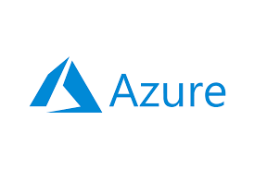


Technologies and Tools Used

Slide 19
Conclusion
In this project, we implemented a medallion architecture for supply chain data on Azure, starting with raw data uploaded to Data Lake Storage. Using Azure Data Factory pipelines, the data is ingested into Databricks, where it is organized into bronze and silver layers: the bronze layer handles cleaning of shipment, delivery, and claim data using Python with Pandas, including calculations for delay duration, reorder flags, and claim aging, while the silver layer merges and transforms data for analysis and visualization. FastAPI microservices provide real-time insights through endpoints for claims summaries, inventory health, shipment logging, and file uploads, all integrated with SQLAlchemy and Pydantic models and automatically documented via Swagger/Redoc. This architecture ensures efficient, scalable, and accurate data processing, enabling seamless analytics, reporting, and decision-making for stakeholders.

Slide 20


Special Mentions
Mr. Janakiram
Mr. Natarajan Murgadoss
Ms. Deeksha Sharma
Ms. Joslyn Coelho

Slide 21
Thank You

Slide 22

Thank You
Any Questions ?

